Slide 1
Homework #3 CAD: Robotic Arm
Group 6: Stephanie Bentley, Allison Moore, Jack Amsbry
10/5/2021

Slide 2
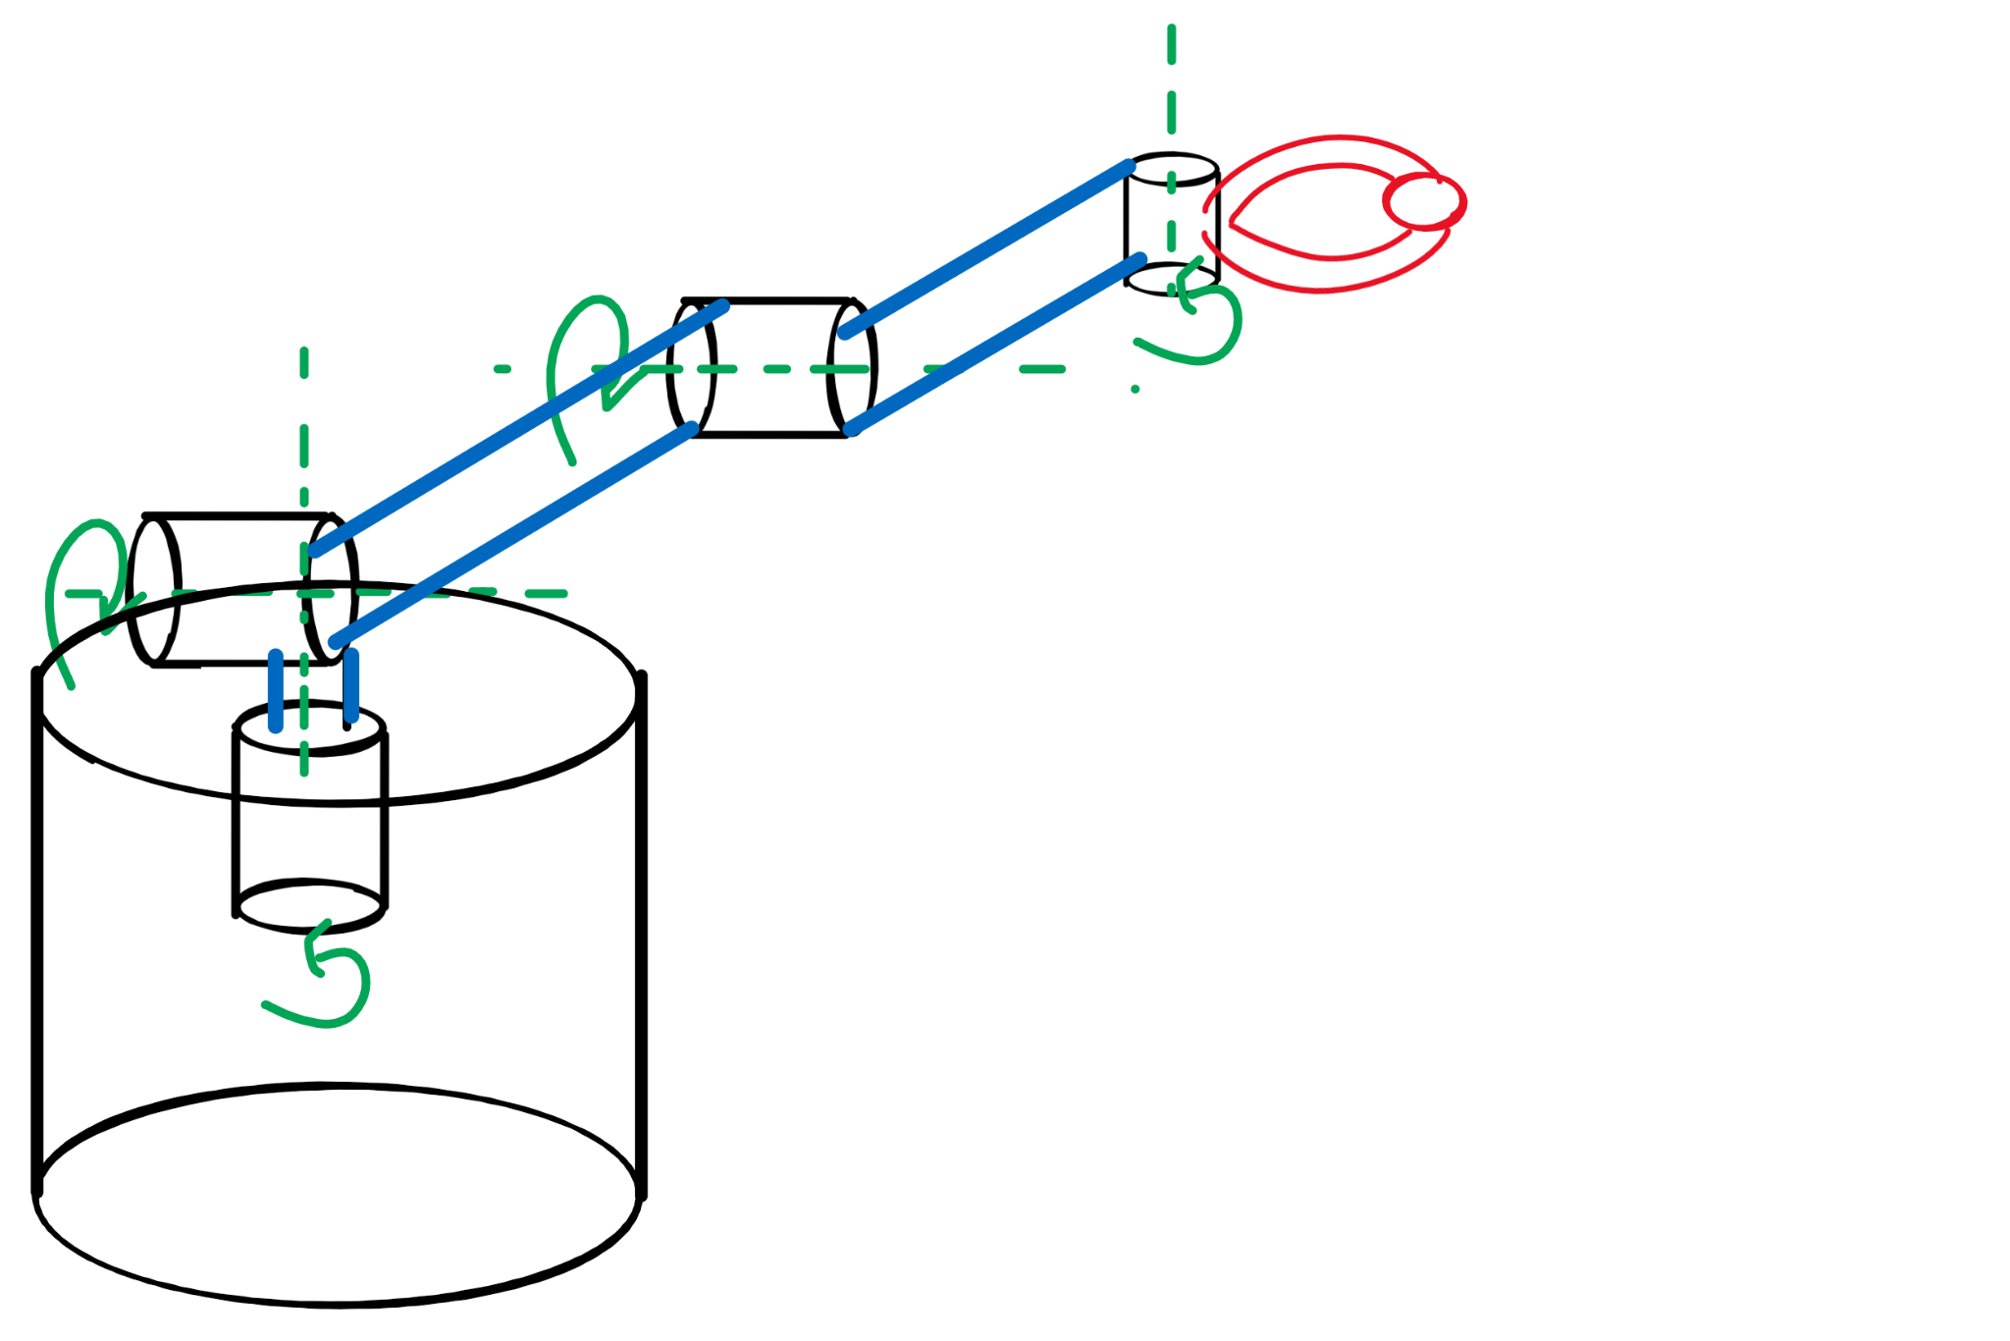
Concept: 4-link 3D Arm
Write letters on a vertical surface
Design a 4-link arm with 3 degrees of freedom and motors to position end effector, plus a small servo to control pen orientation
Stretch goal: using the lidar to map a 3D surface and convert to z coordinates so we can write on a water bottle

Slide 3
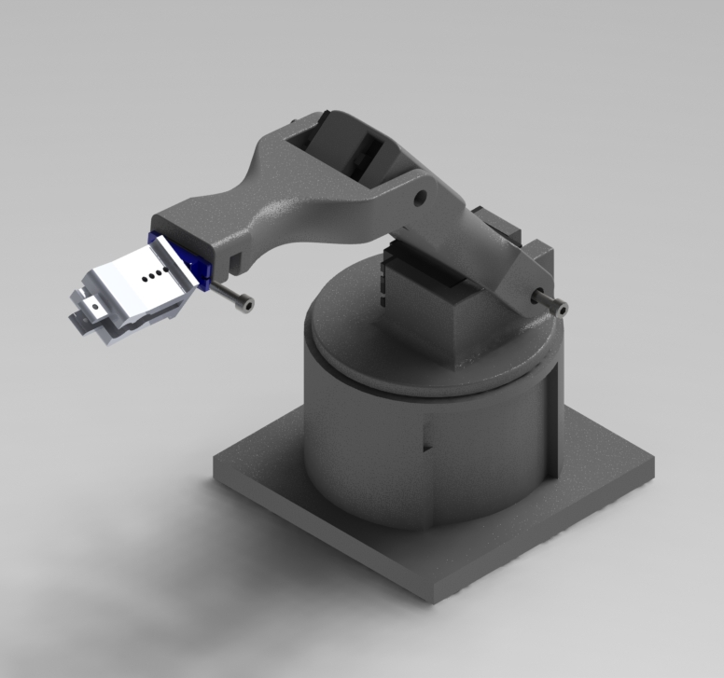
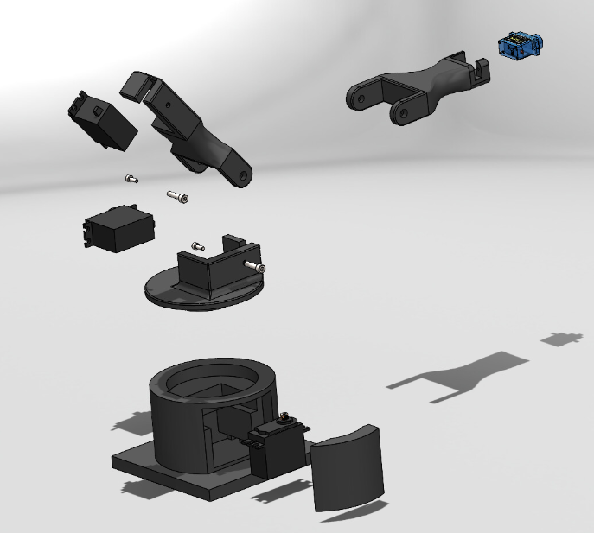
CAD Arm Design
Arm base with ball bearing to reduce friction and support structure

Slide 4


CAD End Effector
Attaches to small servo controlling pen orientation to enable writing on different surface angles
Different holes for different sized pens
Test different lengths for optimal performance

Slide 5
Thank you!
Questions?

